Slide 1

INTRO TO ASYNC JS:
Promises API

Slide 2
Contents
What is asynchronicity and why you should care
Dealing with async code: callbacks vs promises
Promises API: syntax, chaining, error handling

Slide 3
Sync vs async tasks
Synchronous tasks are executed one by one, next task is started only after previous task is finished.
Asynchronous tasks do not wait for other operations to finish before proceeding, multiple tasks can be executed at a time.
You can imagine this as if you are in a line of people waiting to buy train tickets. You can't begin to buy a train ticket until all the people in front of you have finished buying theirs.
You can imagine as if you are eating at a restaurant. Other people order their food. You don't have to wait for them to receive their food and finish eating before you order. Everybody will get their food as soon as it is finished cooking.
Notes:
Similarly, the people behind you can't start buying their tickets until you have bought yours.
Similarly, other people don't have to wait for you to get your food and finish eating before they can order. Everybody will get their food as soon as it is finished cooking.

Slide 4
Is JavaScript asynchronous?
NO.
JavaScript is synchronous, blocking, single-threaded language, only one operation can be executed at a time.
Does it mean that every time you are surfing the Internet and wait for a server response, the UI freezes, no clicks, no scrolling, no animations are possible until it's done?
NO.
JavaScript has special mechanisms to handle asynchronous events in a non-blocking way.
Notes:
To execute several tasks in parallel most programming languages use the concept of threads. The main thread spawns other threads to do some work so that the main program is not blocked.
This is like a restaurant with a single worker who does all of the waiting and cooking. But if this worker works quickly enough and can switch between tasks efficiently enough, then the restaurant seemingly has multiple workers.

Slide 5
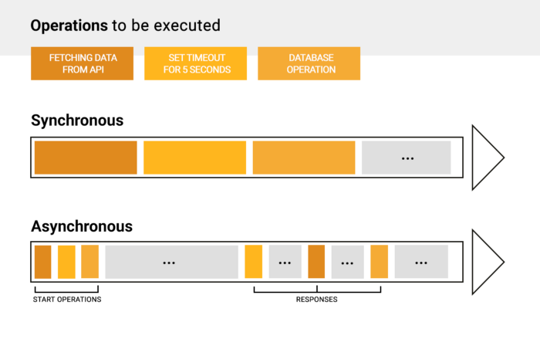
Examples of async events
Making API requests
Querying a database
Reading a file
Uploading an image
Setting a timeout
Clicking on a button
Scrolling a page

Slide 6
Synchronous code
Asynchronous code
is executed in sequence, each statement waits for the previous statement to finish
console.log('First')
console.log('Second')
console.log('Third')
// First
// Second
// Third
doesn’t have to wait for the current statement to finish before moving on to next one
console.log('First')
setTimeout(() => {
console.log('Second')
}, 100)
console.log('Third')
// First
// Third
// Second

Slide 7
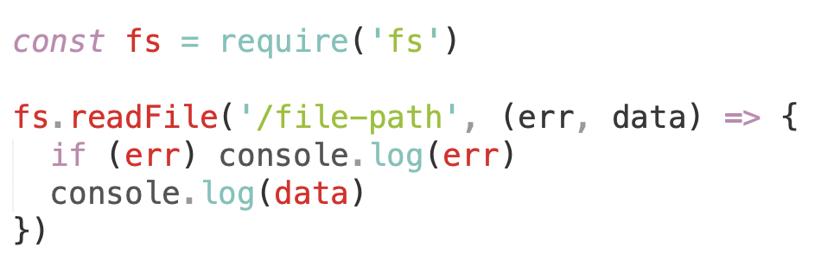
How to know if asynchronous event has finished?
Use callbacks.
Callback is a function that will be executed when an async operation is completed.
The first argument is an error object if some error occurred and null otherwise. The second argument is a result of an async operation.

Slide 8
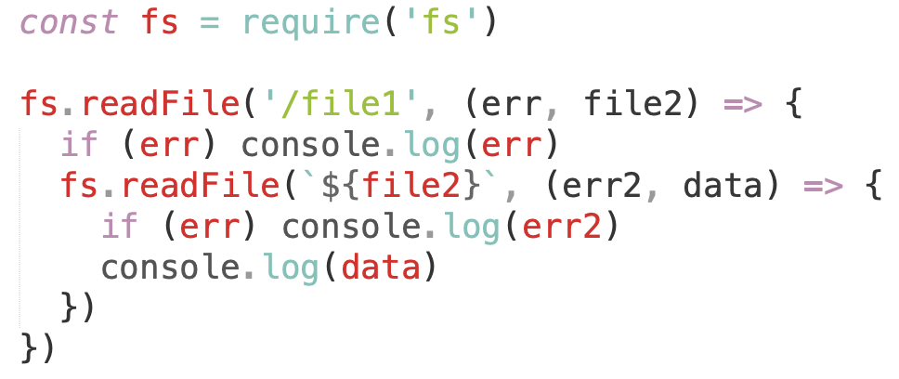
The problem: callback hell
This is a big issue caused by coding with complex nested callbacks.
Here, each and every callback takes an argument that is a result of the previous callbacks.
In this manner, the code structure looks like a pyramid, making it difficult to read and maintain.
It can get even worse...

Slide 9
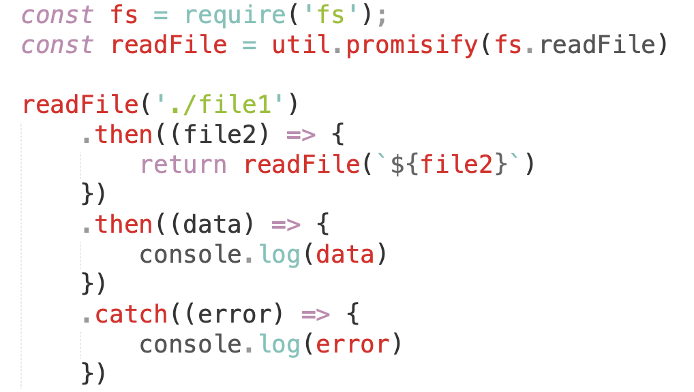
Promises to help you
Promises provide a simpler alternative for executing, composing, and managing asynchronous operations.
Promise is an object that contains the future value of an asynchronous operation.

Slide 10
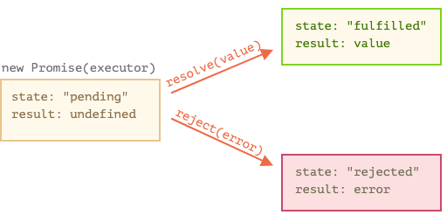
Promise states
A Promise is always in one of three mutually exclusive states:
Before the result is ready, the Promise is pending.
If a result is available, the Promise is fulfilled.
If an error happened, the Promise is rejected.

Slide 11
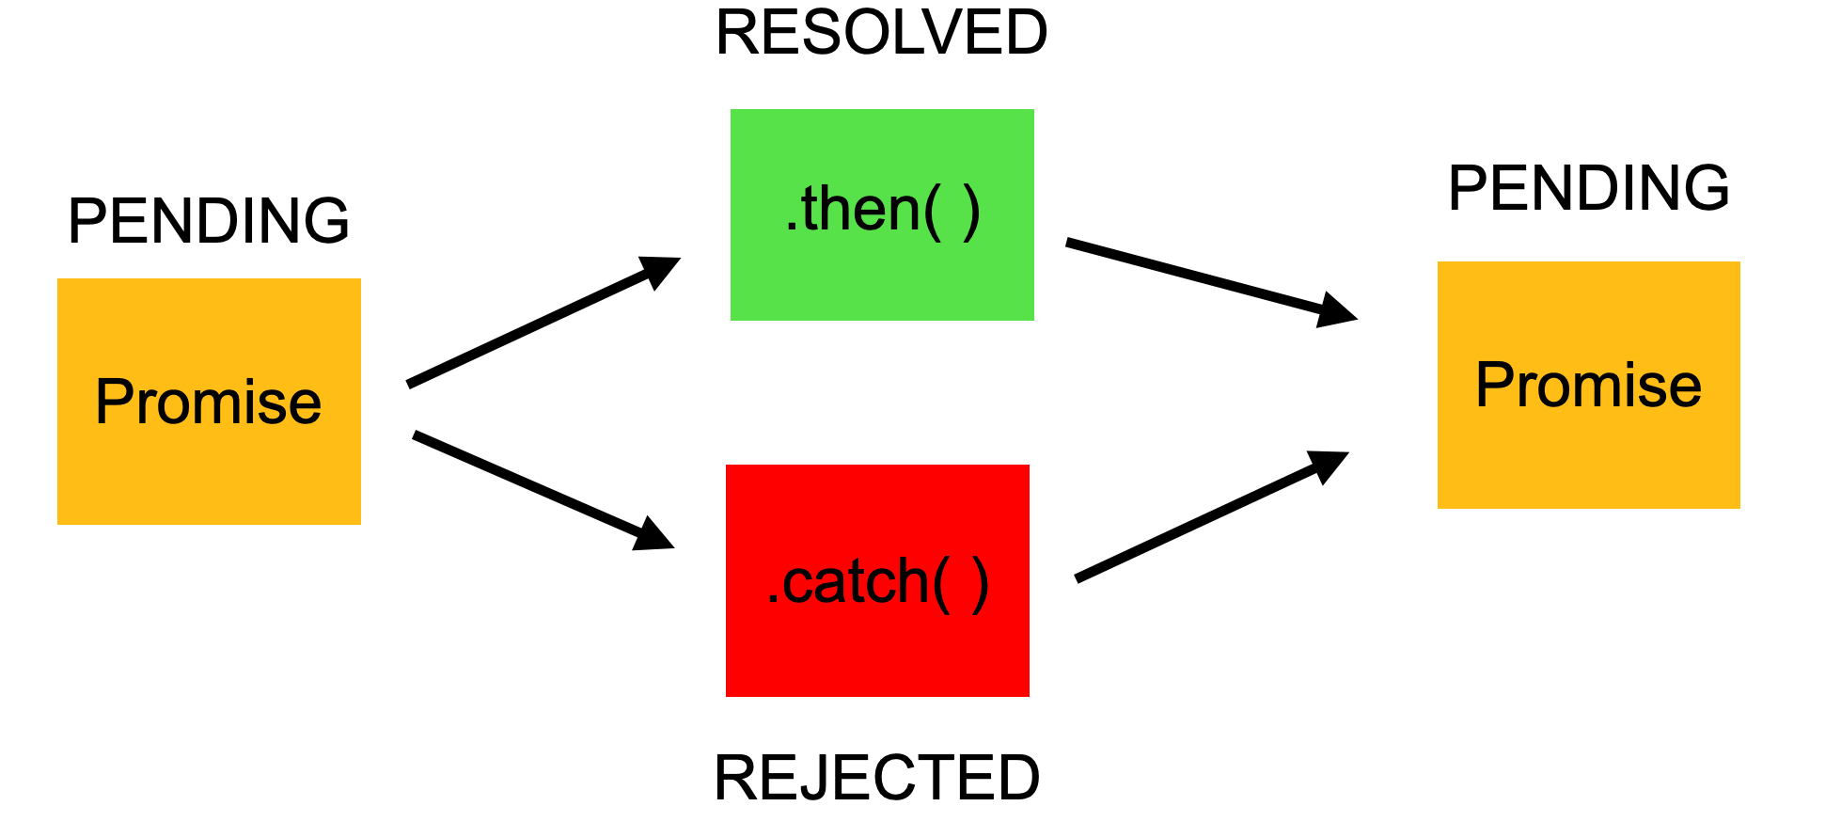
How to handle a Promise
.then() method - to handle a result (resolve) or an error (reject)
.catch() method - to handle errors (rejections)
.finally() method - will be called irrespective of whether a promise resolves or rejects, used for performing cleanups (stopping a loader, closing a live connection)

Slide 12
The following function returns a result asynchronously, via a Promise:
function asyncFunc() {
return new Promise(
function (resolve, reject) {
···
resolve(result);
···
reject(error);
});
}
You call asyncFunc() as follows:
asyncFunc()
.then(result => { ··· })
.then(result => { ··· }, err => throw err)
.catch(error => { ··· })
.finally(() => { … })

Slide 13
Promise chaining
The promise.then() call always returns a promise.
This promise will have the state as pending and result as undefined. It allows us to call the next .then method on the new promise.
The .then method can:
return a value
return a brand new promise
throw an error
In case there is an error or a promise rejection, the .catch method in the chain will be called.
const p = new Promise((resolve, reject) => {
setTimeout(() => {
resolve(10);
}, 100);
});
p.then((result) => {
console.log(result); // 10
return result * 2;
}).then((result) => {
console.log(result); // 20
return result * 3;
}).then((result) => {
console.log(result); // 60
return result * 4;
});

Slide 14
How to handle multiple promises
There are combinator methods which take an iterable (i.e. array) of promises as an input and returns a single Promise that resolves to an array of the results.
Promise.all - waits for all promises to resolve and rejects immediately if at least on of them rejects
Promise.any - returns the first fulfilled value
Promise.race - returns the first settled value (either fulfillment or rejection)
Promise.allSettled - waits for all promises to resolve or reject and returns their results as an array of objects containing a state (fulfilled/rejected) and value.

Slide 15

Is there something better?
Yes.
Async / Await.
Coming in the next lectures :)

Slide 16
Home work
// So you need to achieve following result using Promises
/**
* console.log('1');
* console.log('2');
* console.log('3');
*/
function homeWork() {
// homework code goes here
}
Link
function logIn500Millis() {
setTimeout(() => {
console.log(1);
})
}
function logIn100Millis() {
setTimeout(() => {
console.log(2);
})
}
function logIn300Millis() {
setTimeout(() => {
console.log(3);
})
}

Slide 17
Links
Code examples from this lesson
About asynchronous JS from MDN
Simple explanation of async JS
Promise docs

